Slide 1
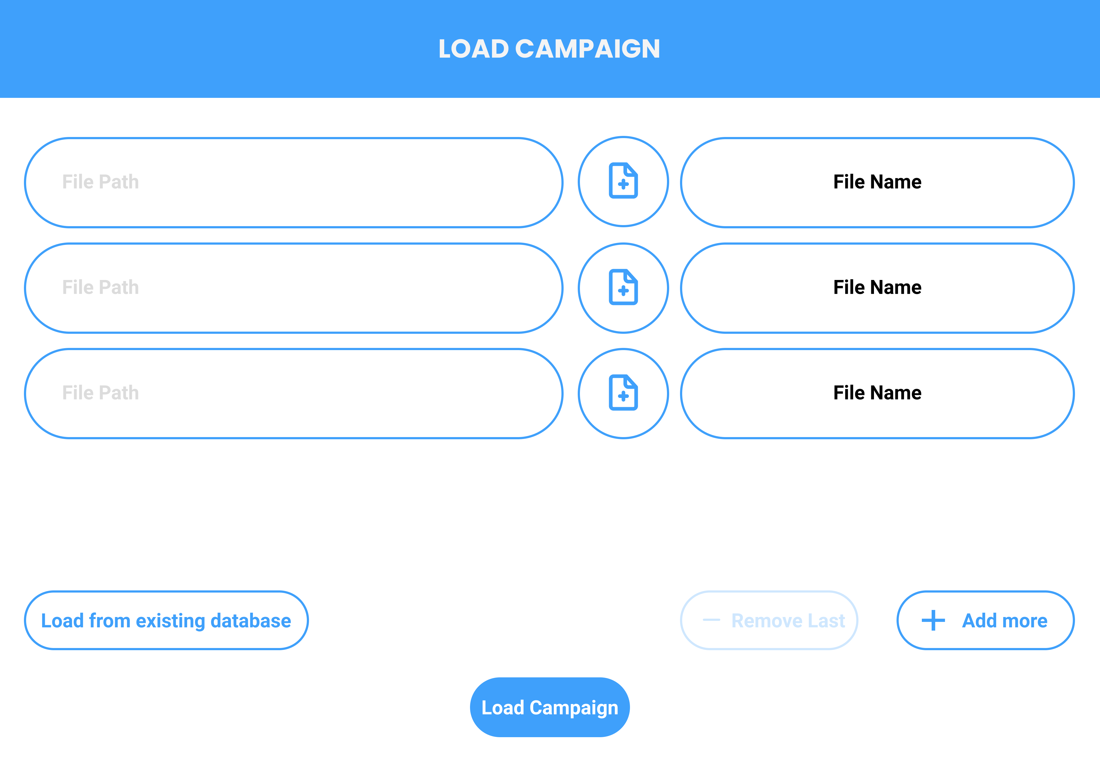
START UP SCREEN TO LOAD CAMPAIGN
File Path will be displayed here
Click on file selector icon to open filechooser
File path can also be input directly
File Name will be displayed here.
Also acts as a dropdown list to select file to upload
Log files are used to create a database, that defines the campaign
Reads files selected and creates the campaign database for display
Adds row to load additional files
User can load database/ campaign directly
Removes last loading row, but cannot remove top 3 essential rows

Slide 2
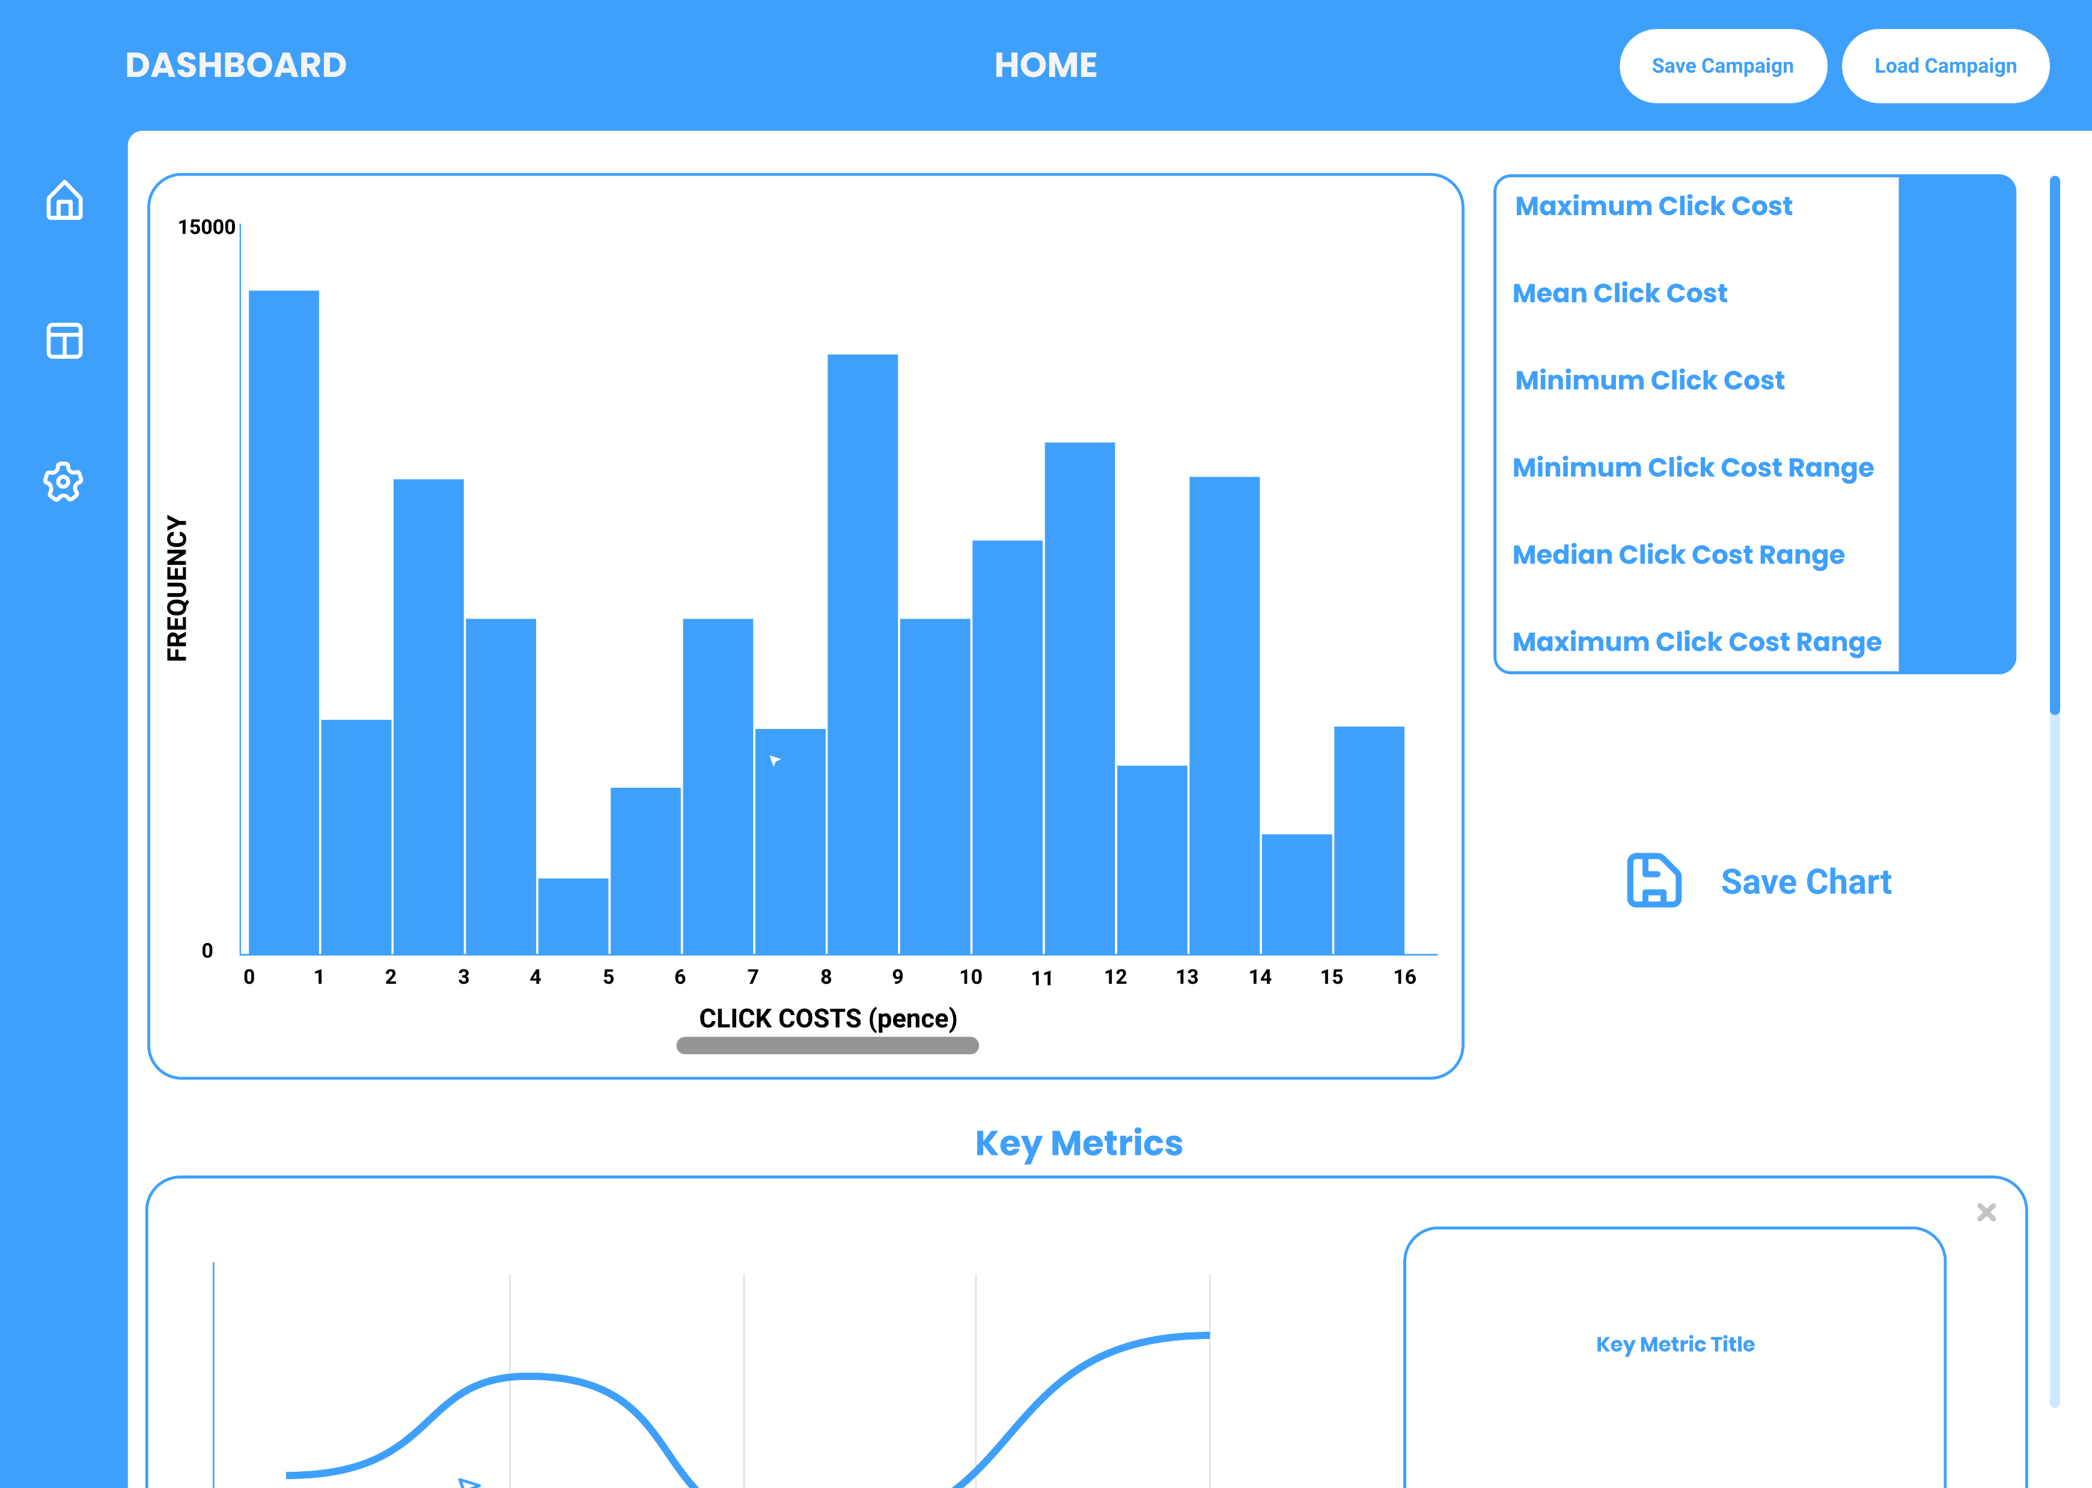
Side Buttons
Click to go back to load campaign screen
Compare campaigns function
Saves the campaign database
Settings button for accessibility features
Statistics on Click Cost
Histogram of Click Costs
Saves the histogram chart as a PNG
Key Metrics Section
Scroll Bar used to view key metrics below

Slide 3
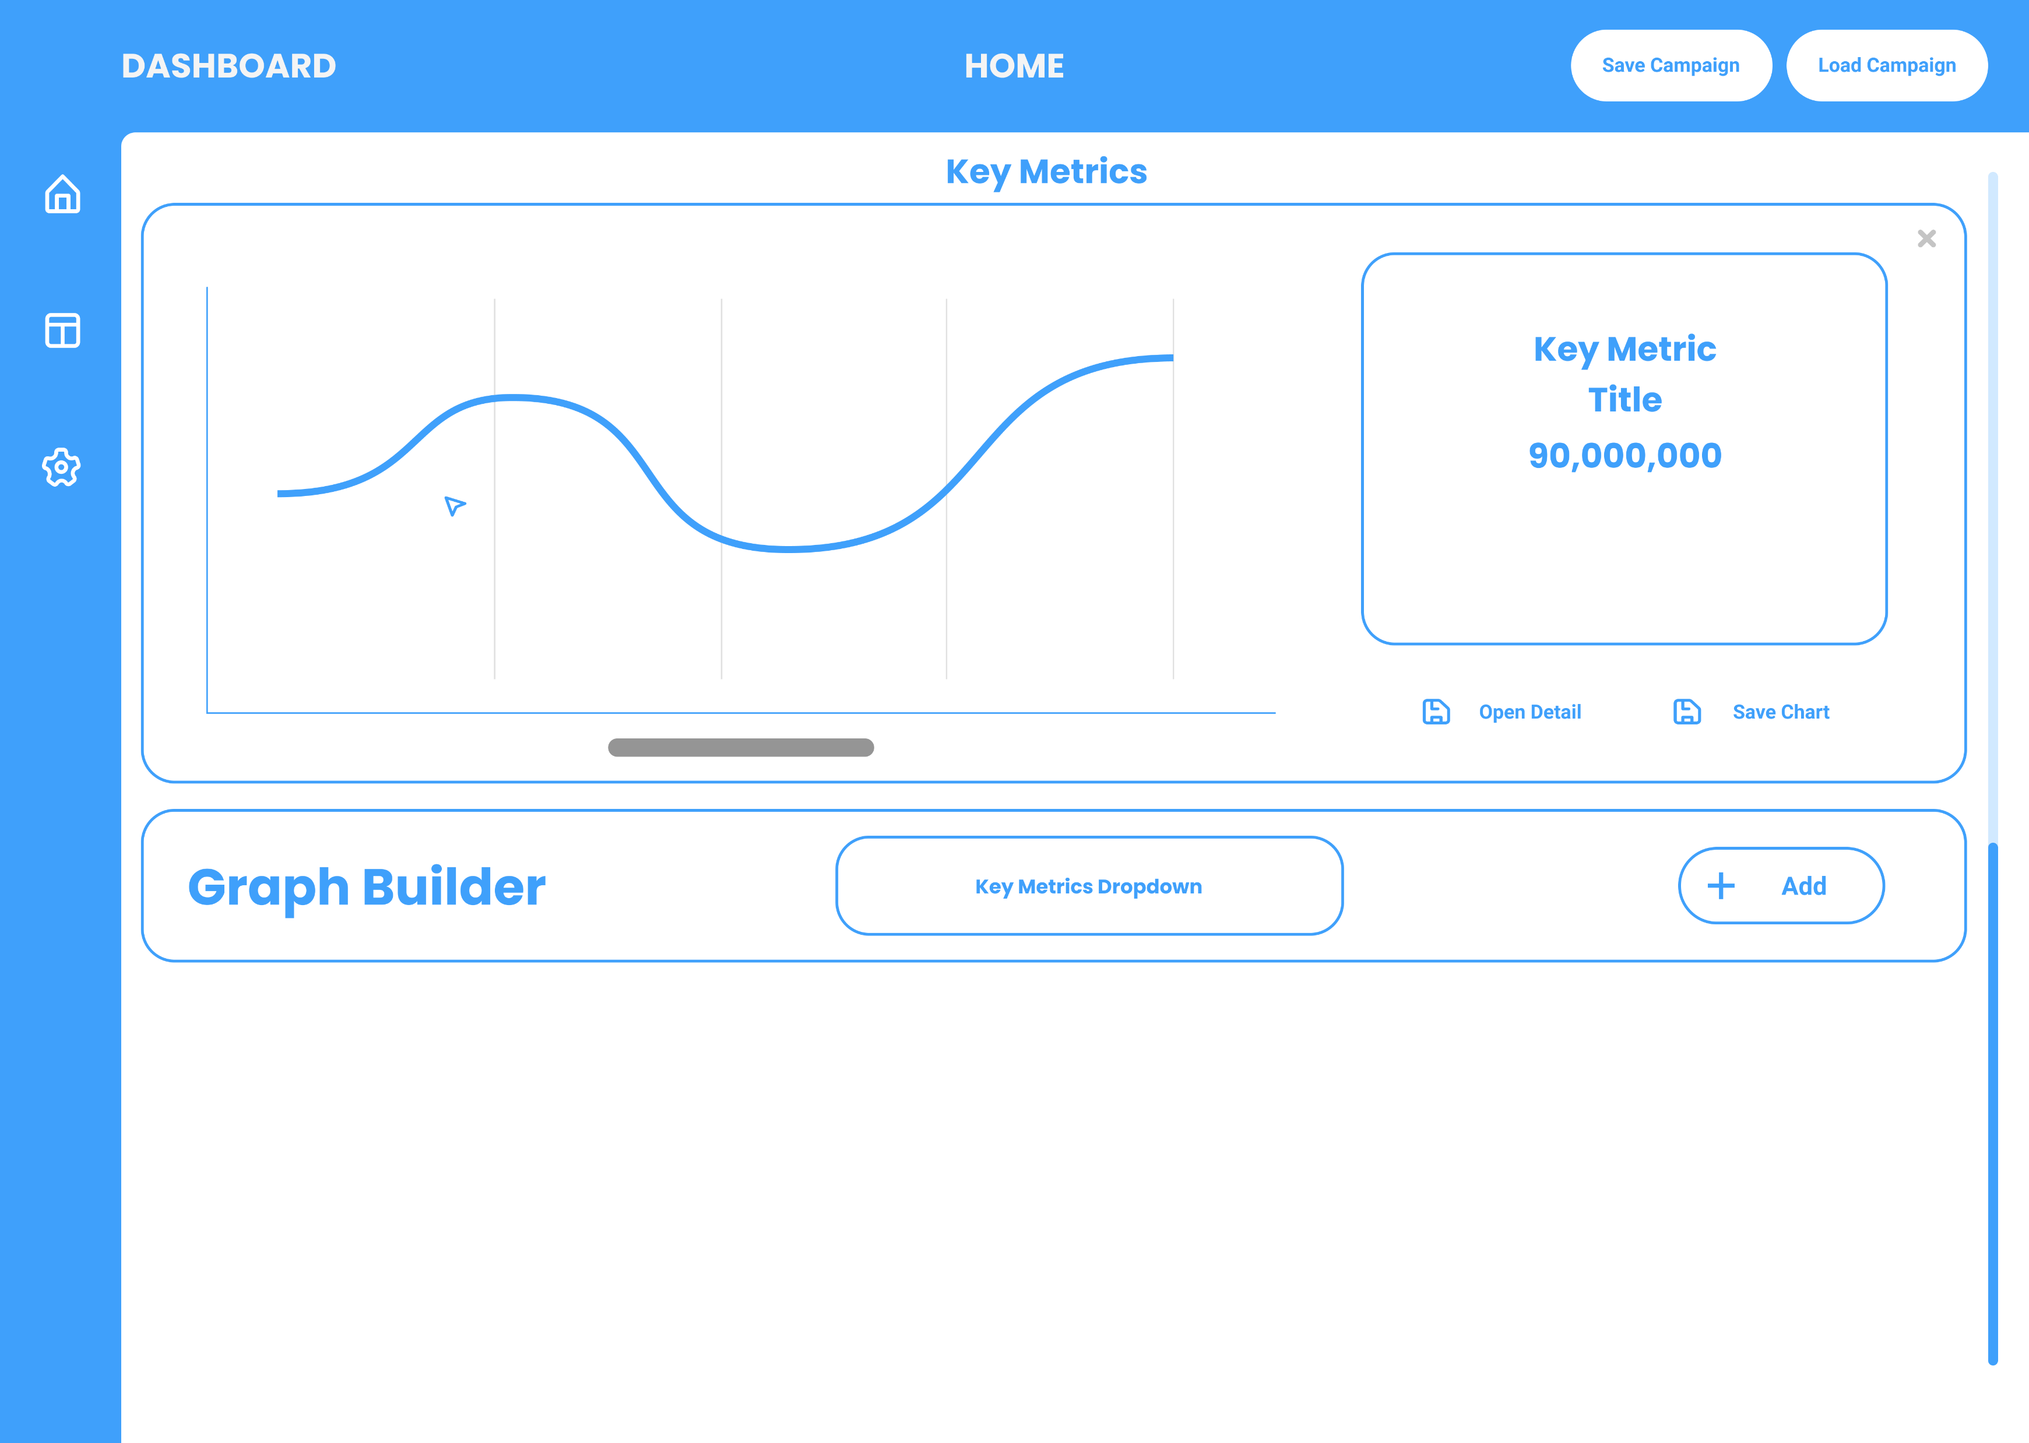
Metric Time Graph
Metric Title with attribute number describing key metric
Graph Builder section displays metric rows on window
Opens Detail View that displays information about metric
Saves the metric chart as a PNG
Dropdown list to select desired metric to display
Add Button to display selected metric from list

Slide 4
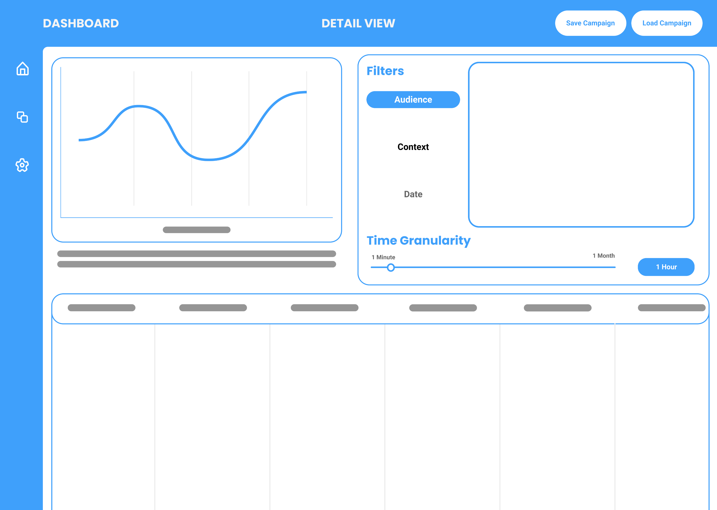
Click on Home button to get back to Campaign Page
Filters the metric and the chart
Clicking on each filter to get relevant detail
Side-to-Side View used to compare metric on two filters
Area to display details of filter panels
Metric Name & Description
Time Granularity Slider changing the time range of data points
Table displaying relevant data for metric

Slide 5
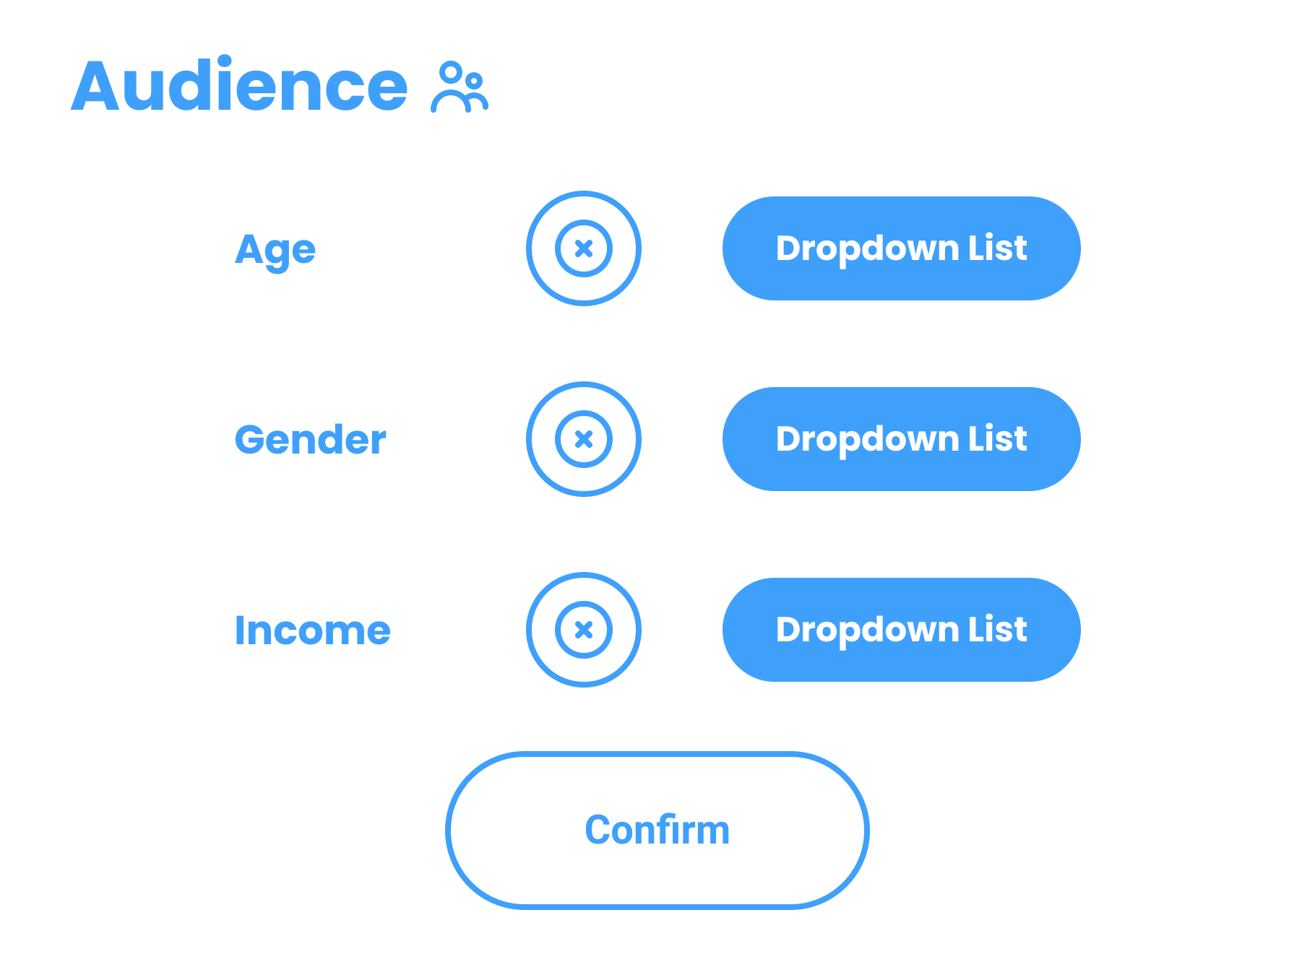
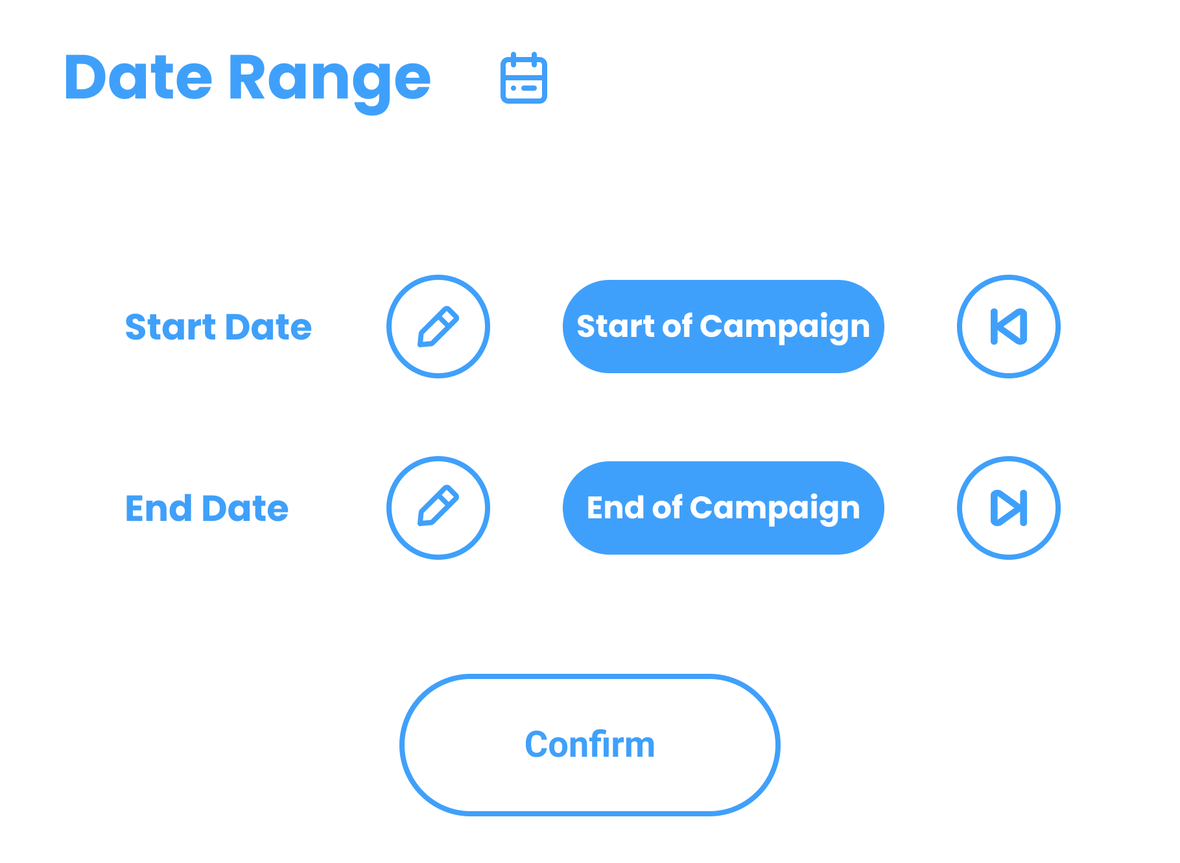
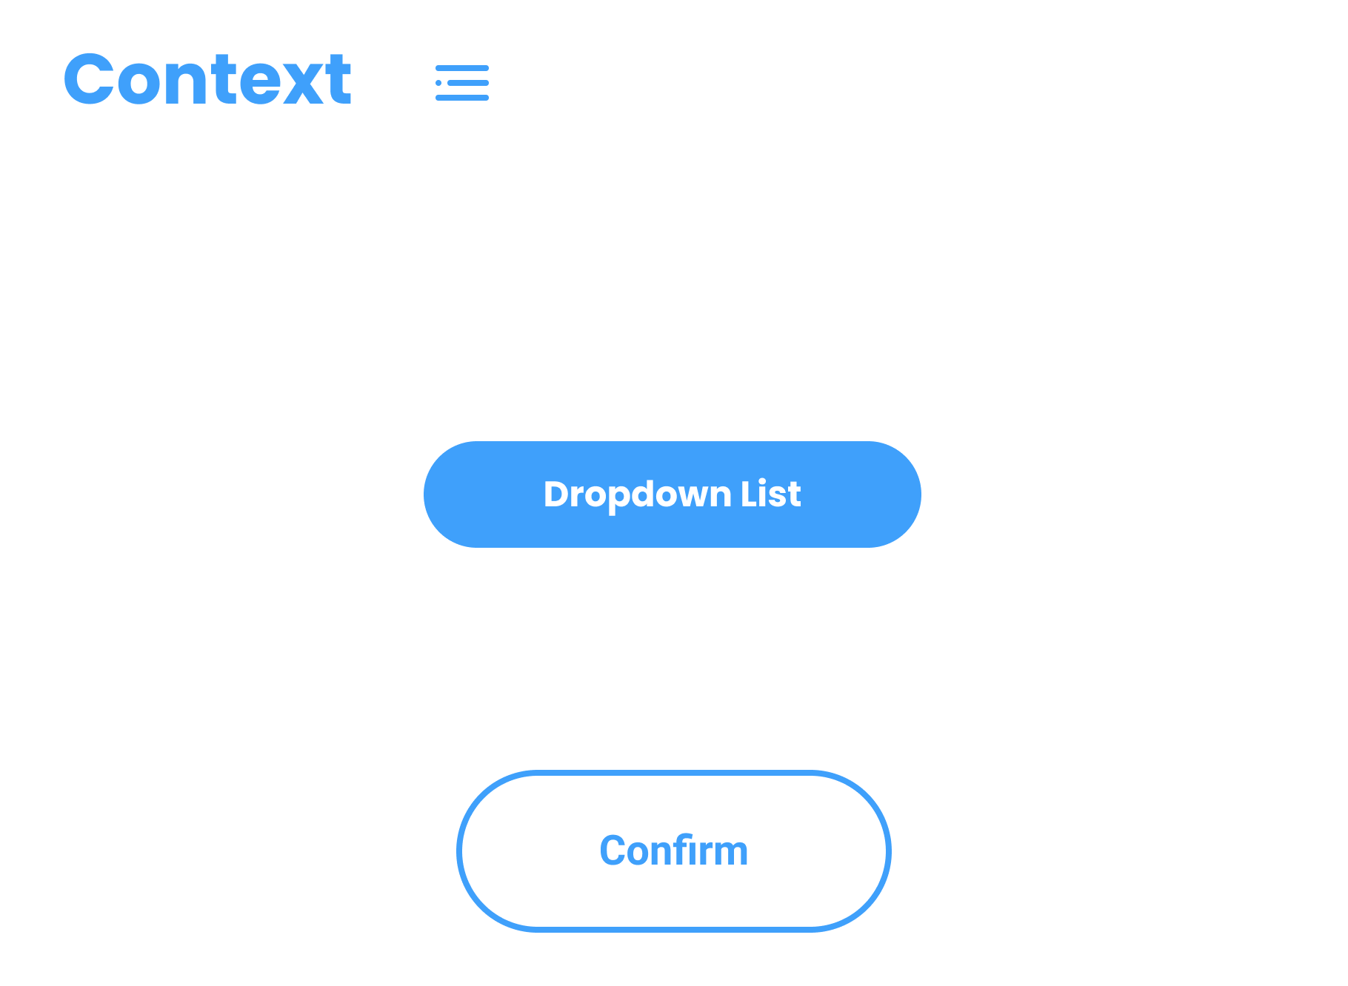

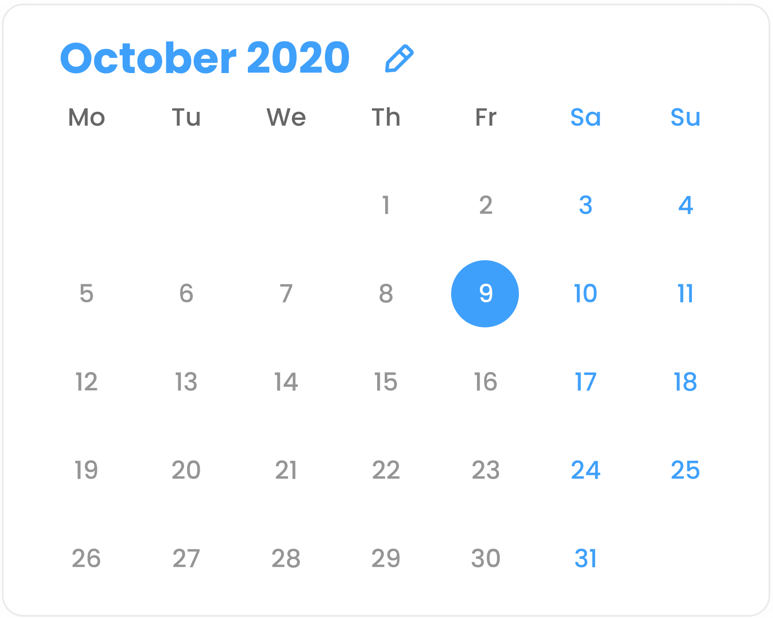
Audience Filter Category will incorporate 3 audience segments (Age, Gender, Income)
FILTERS
Displays date selected
Rewinds back to start of campaign
The panels will be displayed in the dedicated filter area on the detailed view of metrics to allow the user to choose their filter values.
Selecting specific filters will open respectively linked panels
Toggle icon to select desired filter
Clicking on the edit button will open the calendar to select the date
Skips to end of campaign
Checkbox dropdown list of filter values

Slide 6
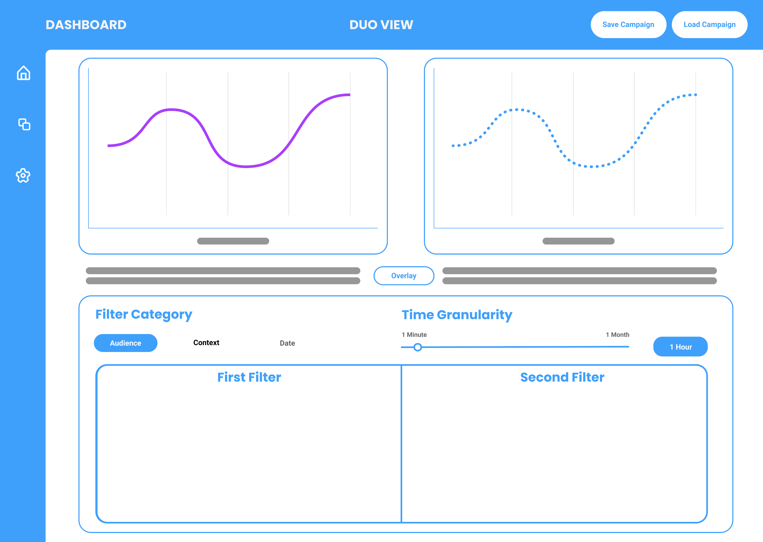
Duo View displays the two charts side to side view for comparison
Graph in dotted points as colour blind accessibility feature
Graph in purple for colour association
Overlay button to merge and display the graphs
Filter Category to select wanted filter
Time Granularity Slider changing the time range of data points
First filter detail selection affecting left graph
Second filter detail selection affecting right graph

Slide 7
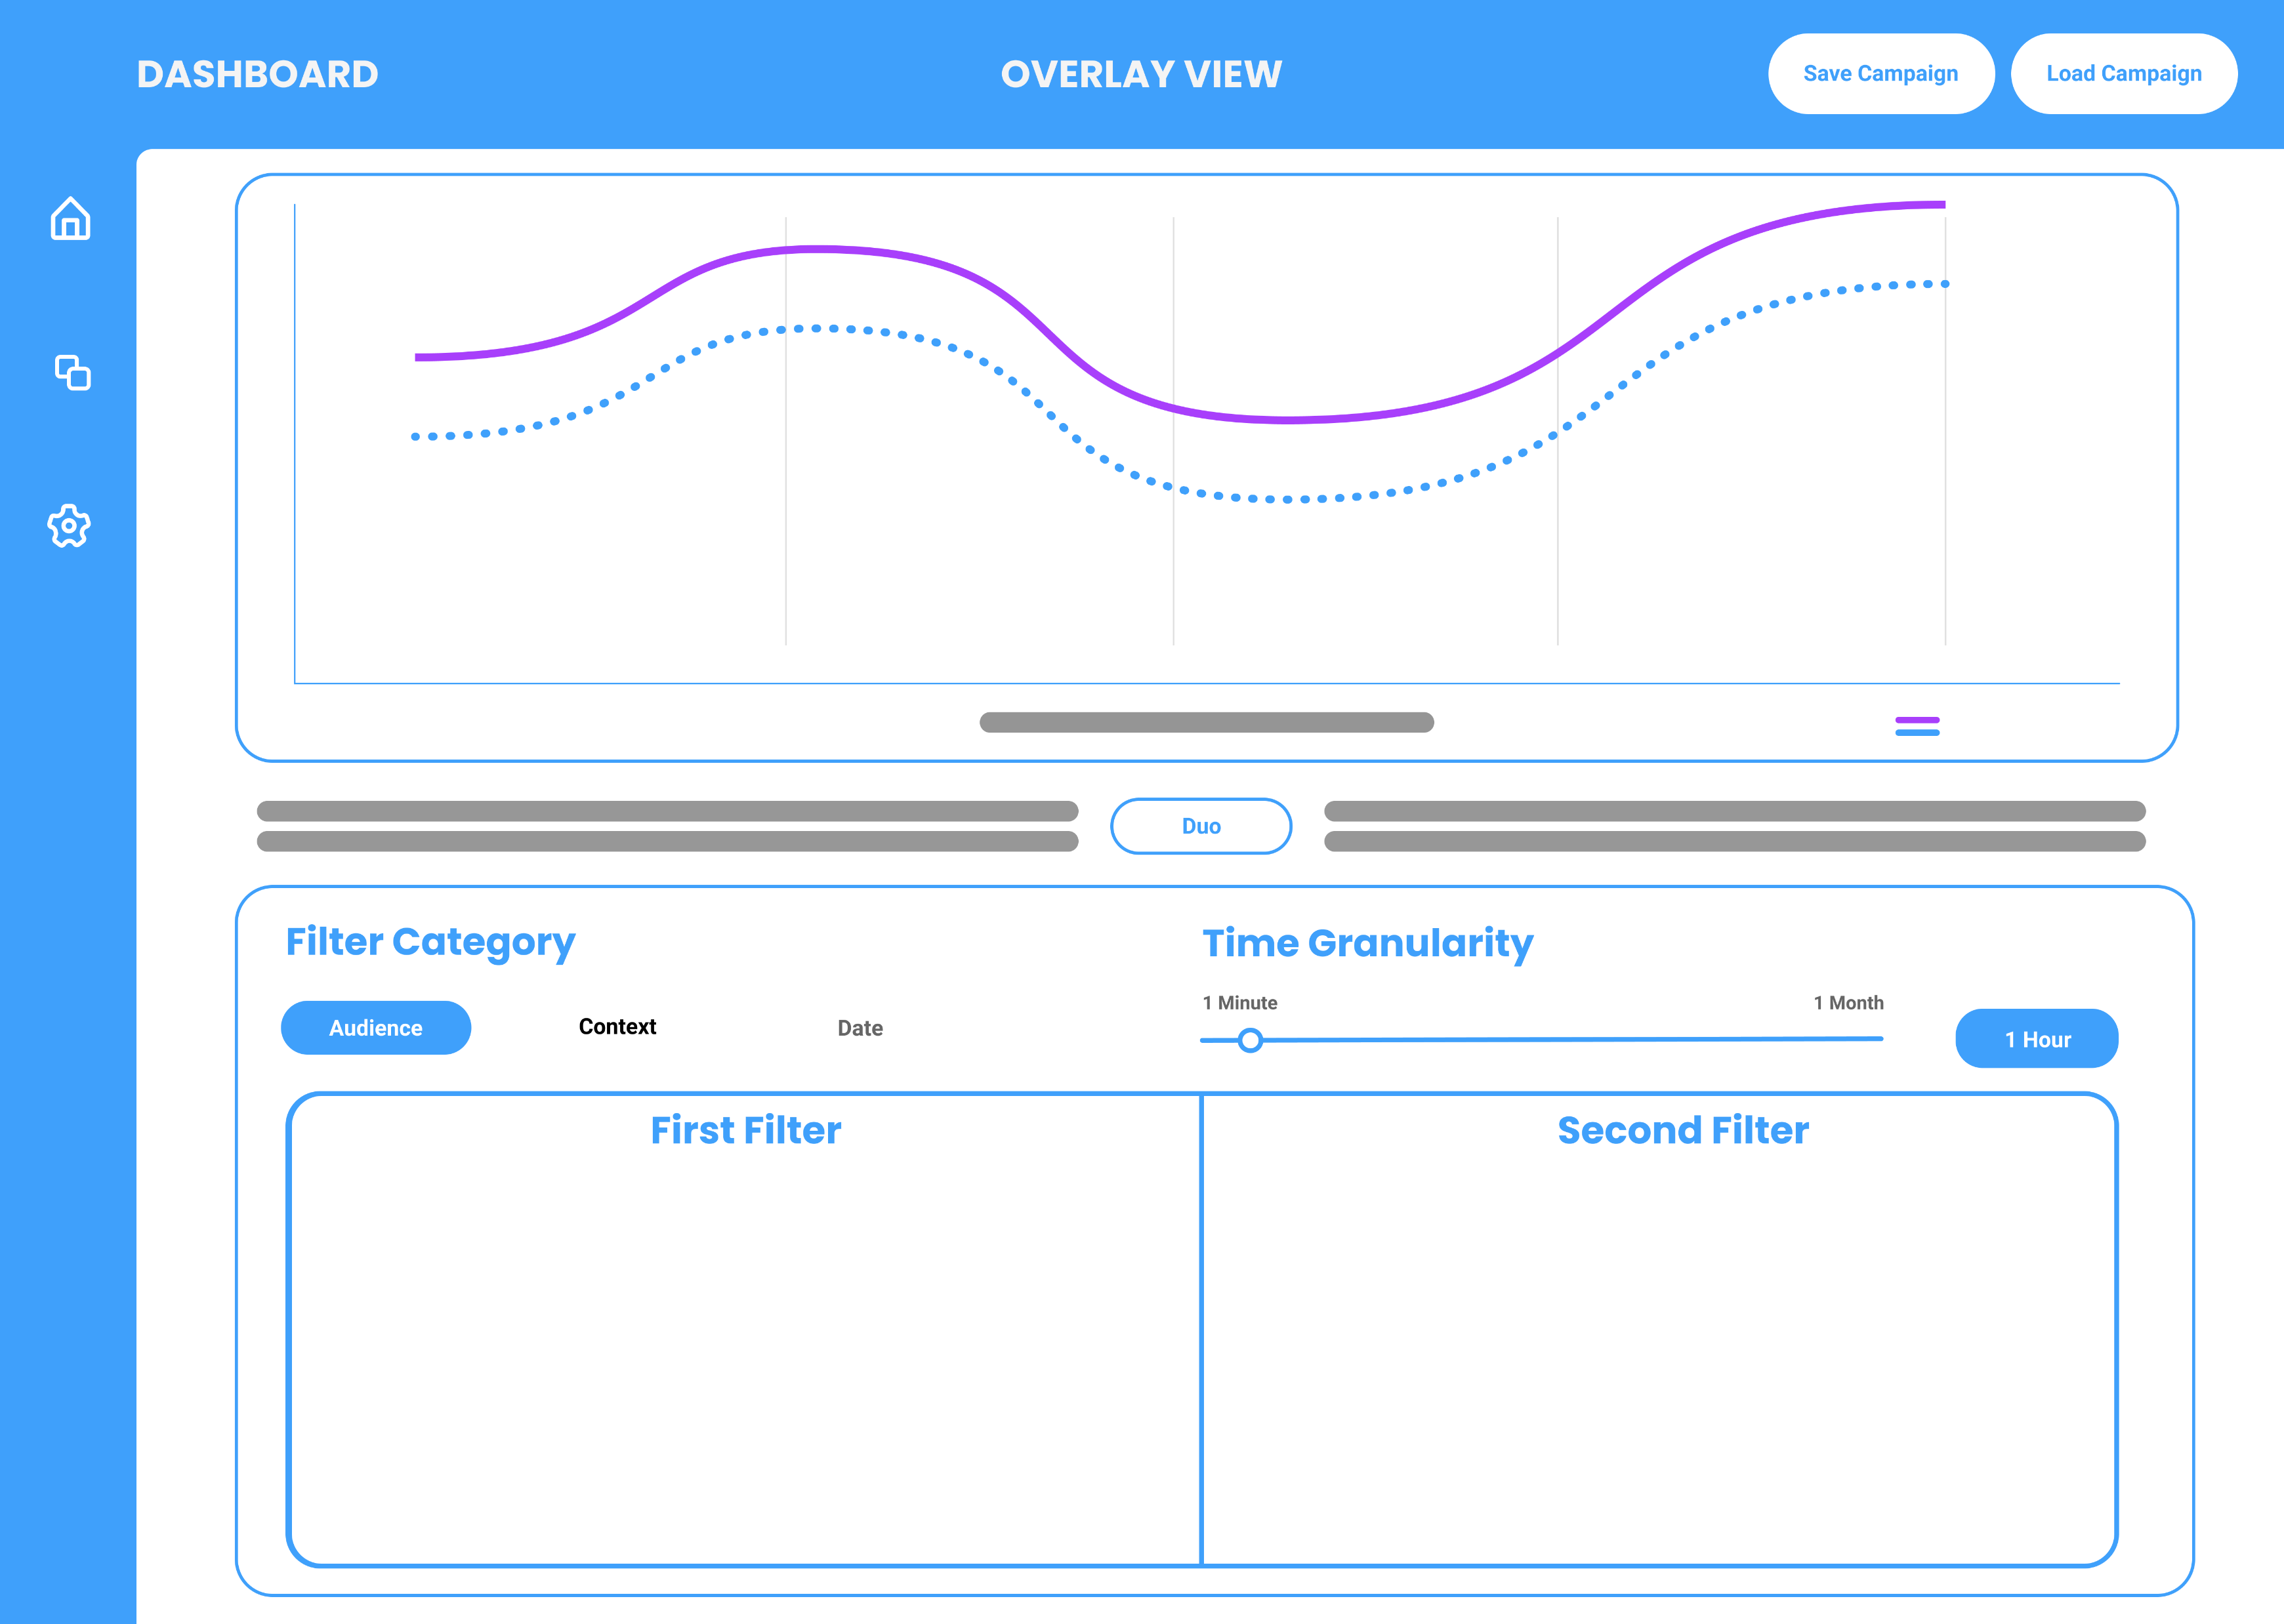
Overlay View displays the two charts in overlay manner for comparison
Metric Name
Colour code key
Duo button to separate and display the graphs side to side
Filter Category to select wanted filter
Time Granularity Slider changing the time range of data points
First filter detail selection affecting graph in blue
Second filter detail selection affecting graph in purple

